Slide 1

Heart Disease Indicator Project Outline
Team 4
Notes:
Monse

Slide 2

Our team
Dylan D’Costa
Kevin Zhuang
Abish Rego
Monserrat Hernandez
Notes:
Monse - Our team is composed by Dylan Costa, Kevin Zhuang, AR and Monserrat

Slide 3
The purpose
We ran our analysis for the whole dataset, then
We found a correlation between a heart disease and:
General Attributes
Illness history
Lifestyle
Notes:
Monse - We want to find out if certain attributes contribute to having or not a heart disease

Slide 4

The dataset
https://www.kaggle.com/datasets/kamilpytlak/personal-key-indicators-of-heart-disease/data
2022 annual CDC survey data of 400k+ adults in the United States related to their health status
246,023 rows of already cleaned data in CSV format
Notes:
Monse - Our dataset was downloaded from Kaggle, this dataset was originally built by the CDC collecting data from 400k adults and we used a version which was already cleaned where we analyzed more than 200k rows

Slide 5

Our findings
Notes:
Monse - Now, we are going to talk about what we’ve found after our analysis

Slide 6
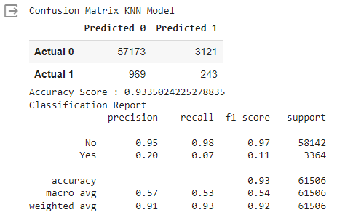
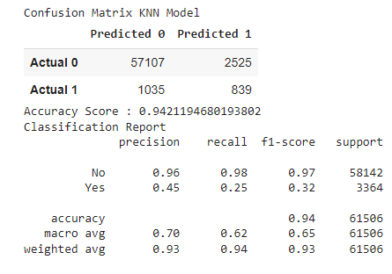
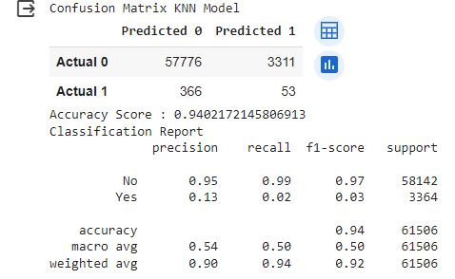
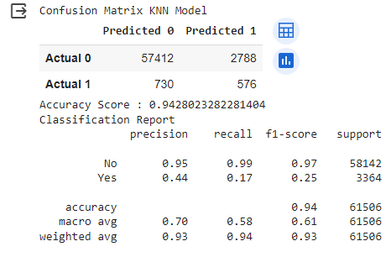
General Attributes
Illness History
KNN Model Confusion Matrix Accuracy Score
Classification Rpt.
Lifestyle
Whole Dataset
Notes:
Dylan.Before we delve into these models want to just explain briefly what General Attributes, Illness History and Lifestyle mean. General Attributes was taking into account columns in the whole dataset such as Height Weight BMI, Sex and Age. Illness History was to be brief looking at patient history to see if they had Angina, Chronic Obstruction Pulmonary disease, Arthritis, Cancer etc.. and finally Lifestyle was looking at survey attributes such as regular exercise, alcohol consumption, cigarette smoking, e-cigarettes usage etc. We started out with KNN is one of the simplest forms of machine learning algorithms mostly used for classification. We got fairly robust results.

Slide 7
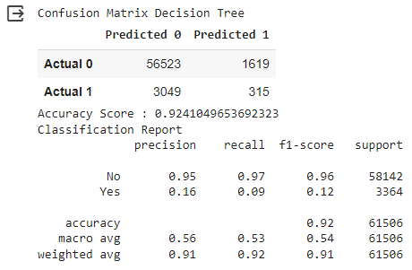
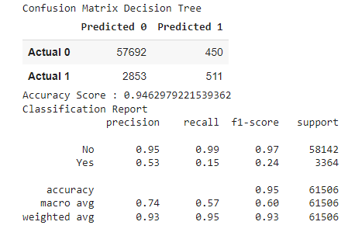
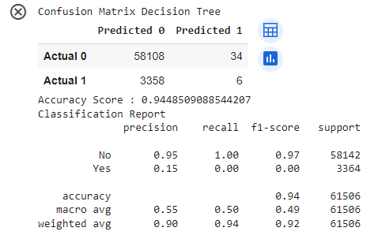
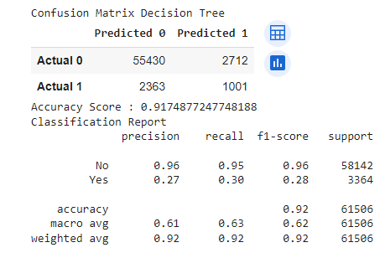
General Attributes
Illness History
Decision Tree
Confusion Matrix Accuracy Score
Classification Rpt.
Lifestyle
Whole Dataset
Notes:
Decision Trees (DTs) are a non-parametric supervised learning method used for classification and regression and the results were still fairly robust over here.

Slide 8
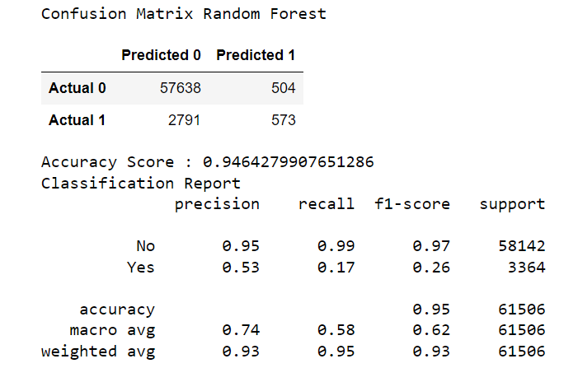
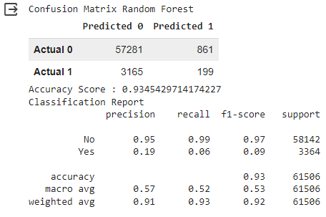
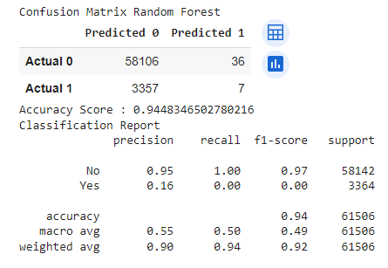
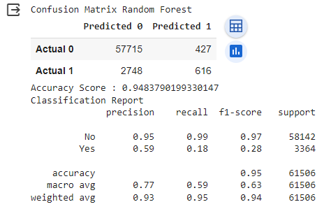
General Attributes
Illness History
Random Forest
Confusion Matrix Accuracy Score
Classification Rpt.
Lifestyle
Whole Dataset
Notes:
Random forest is a commonly-used machine learning algorithm which really combines the output of multiple decision trees to reach a single result. It gave us the best results of the three models with an accuracy score of .9483 because it handled the imbalance dataset better.

Slide 9
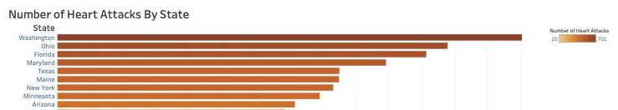
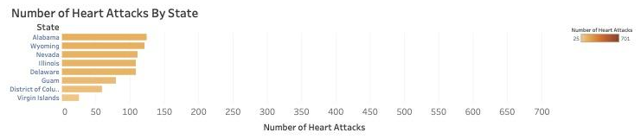
Notes:
Kevin - Washington, Ohio and Florida are the top 3 states having the MOST number of heart diseases.
While the states of Virgin Islands, Columbia and Guam are the top 3 states having the LEAST number of heart attacks

Slide 10
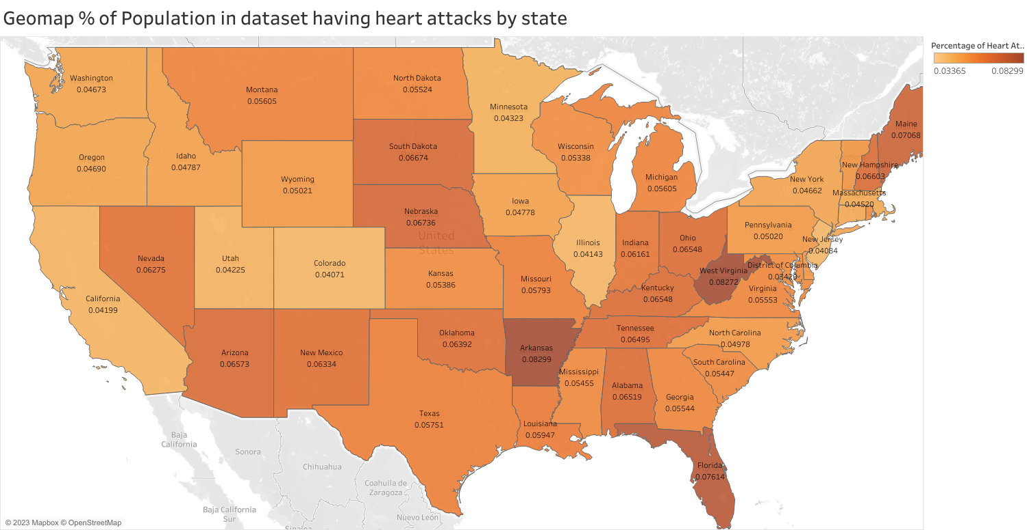
Notes:
Kevin - West Virgina, Arkansas and Florida are the top 3 states having the MOST percentage of population having a heart diseases.

Slide 11
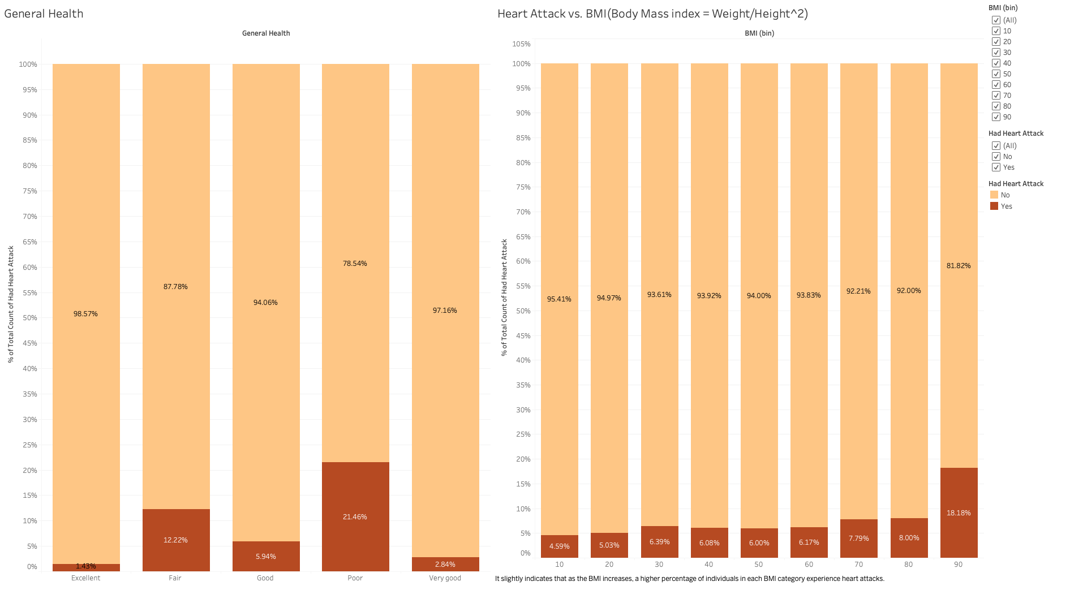
Notes:
Kevin - BMI Healthy range: 18.5 - 24.9; overweight: 25 - 29.9; obese range: < 30, there is a trend indicating that higher BMI correspond to a higher percentage of heart attacks.

Slide 12
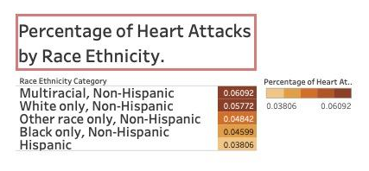
Notes:
Kevin - We found that a heart disease does not discriminate but there’s a clear tendency for hispanics to have least number of heart attacks.
This means that if our analysis is correct, white population may struggle more to get medical attention of a heart disease, possibly due to the higher cost of medical services.

Slide 13
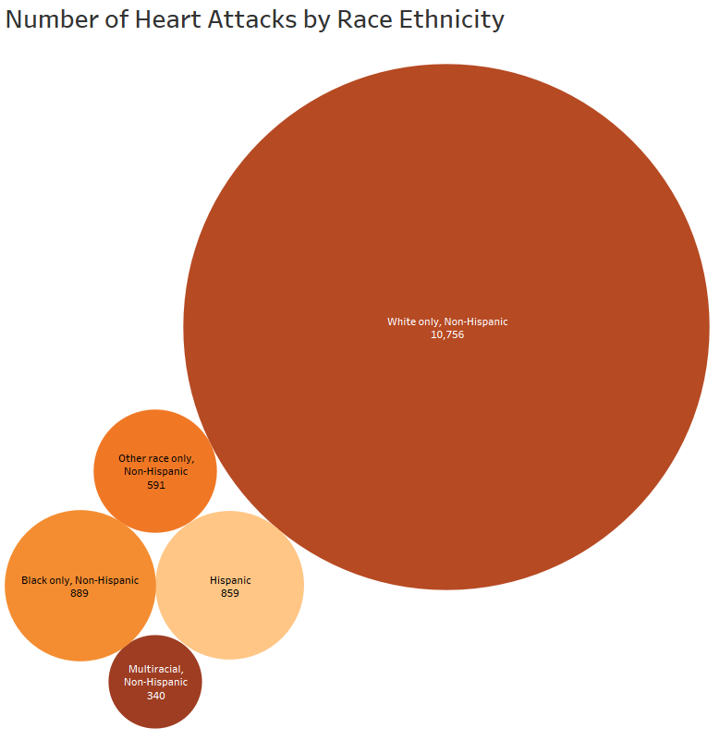
Notes:
Kevin - From the previous slide we found that Hispanics from this dataset were least likely to suffer from a heart attack but the disparities in the percentages weren’t stark. However, looking at the number of heart attacks by race ethnicity suggest that the data is skewed to the extent that there is a huge white only-non hispanic population in this dataset. It could be a function of the demographics in the US in general but could also point to the possibility of a disparity with access to healthcare and healthcare insurance..

Slide 14
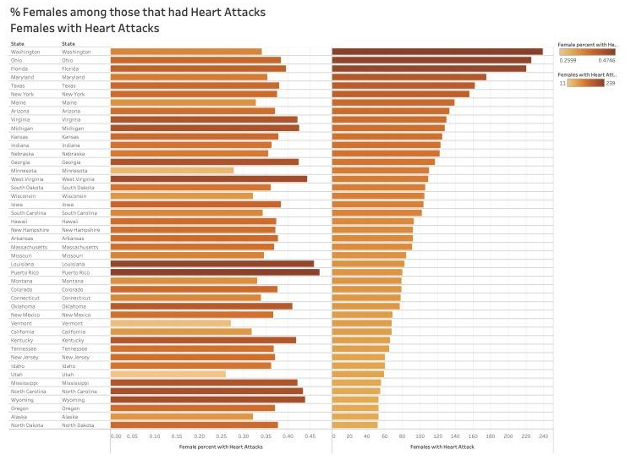
Notes:
This is interesting to the effect that it shows us perhaps there is a slight skew in the data. While on a percentage basis Puerto Rico and Louisiana show the highest propensity of women to suffer a heart attack, however the data when it comes to the sheer number of heart attacks by state - Washington Ohio and Florida are in the lead - perhaps indicating a preponderance of data from certain states versus others.

Slide 15
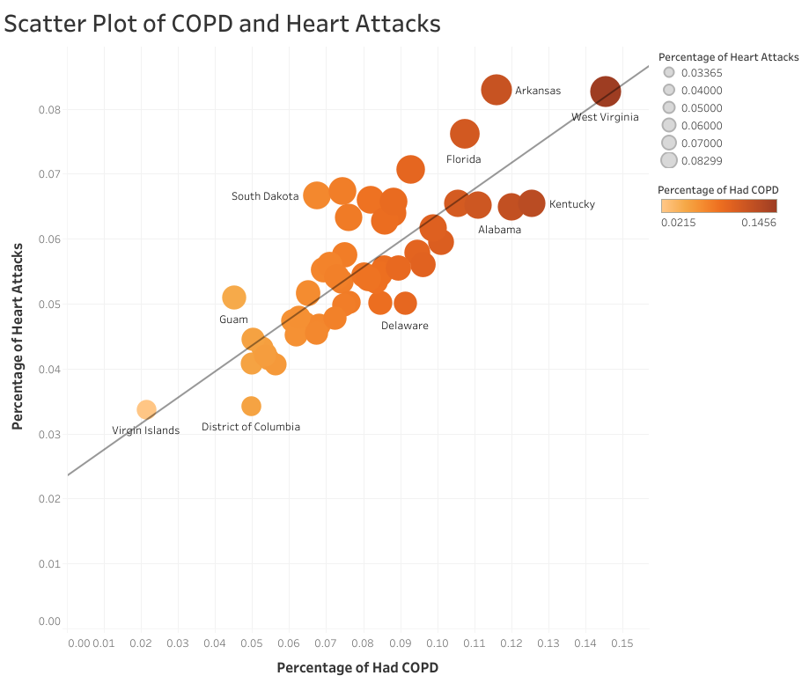
Notes:
While analyzing the correlation between a heart attacks and COPD (Chronic Obstructive Pulmonary Disease) the correlation measured by r-squared is marginally lower than Angina at 0.693

Slide 16
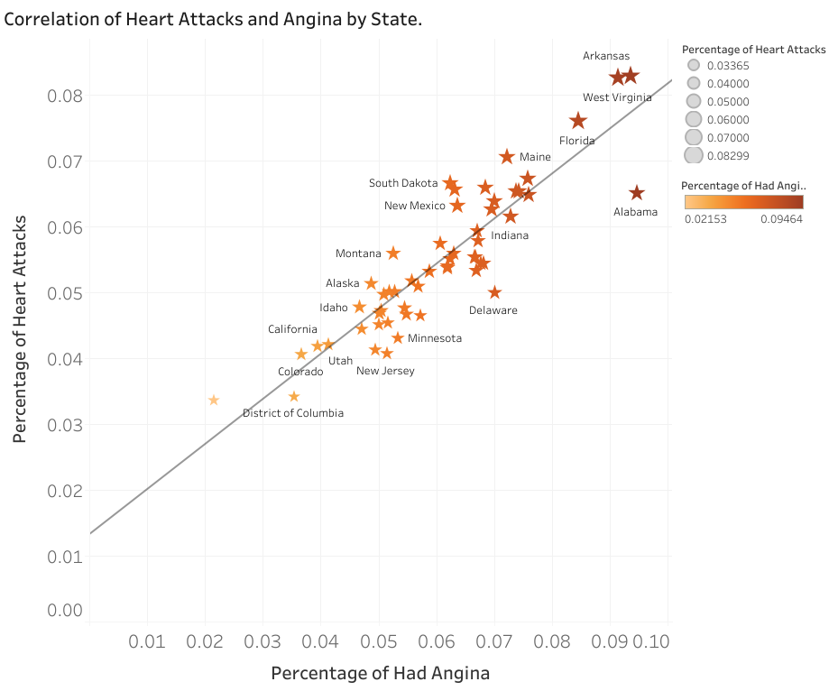
Notes:
By doing a correlation graph you can see graphically that there’s a clear correlation between those having angina also likely to have had a heart attack. In fact the r-squared is 0.803

Slide 17
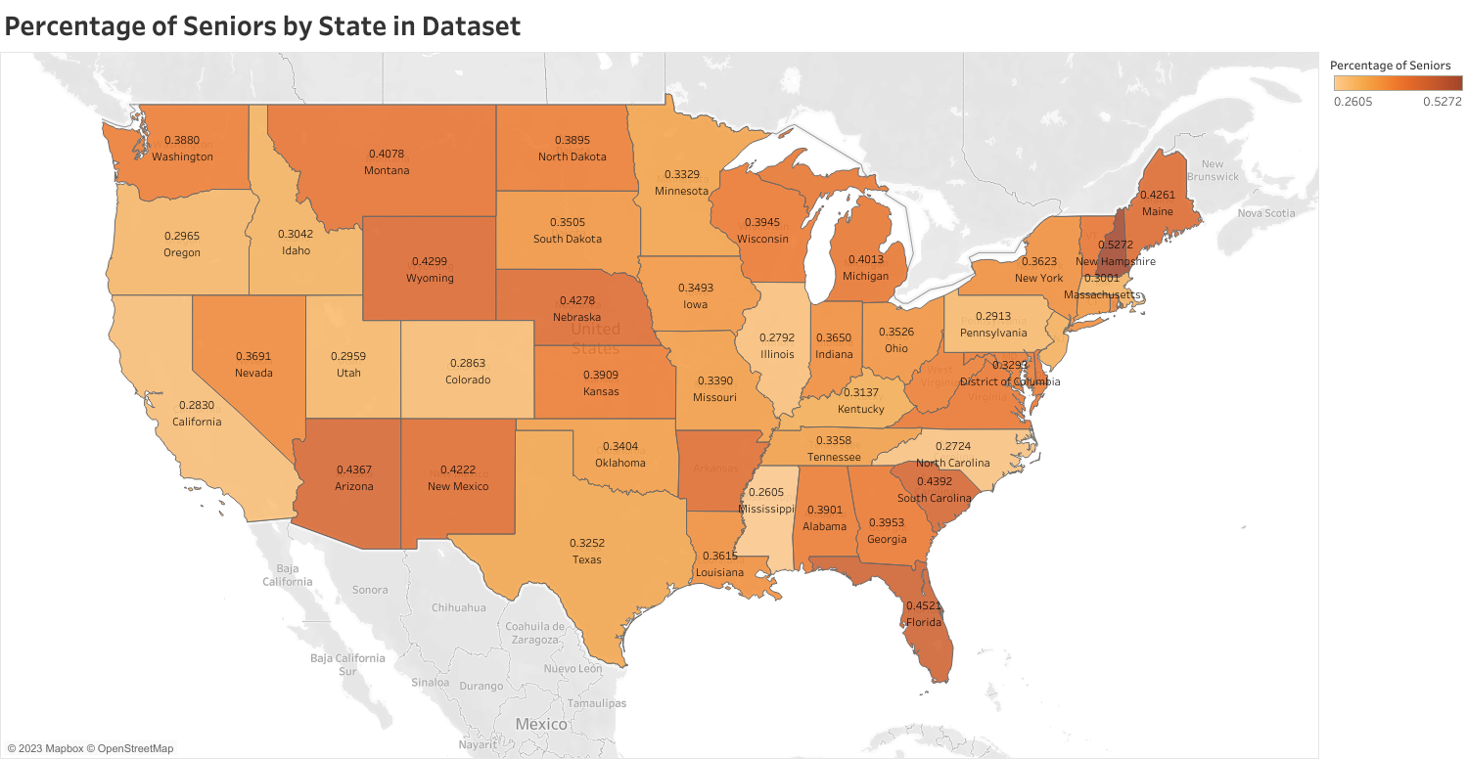
Notes:
Finally, this graph shows a correlation between persons who had a heart attack and were smokers. As you can see there’s no clear relationship of this, essentially, if you are a smoker, it is very unlikely that you’ll get a heart attack.

Slide 18
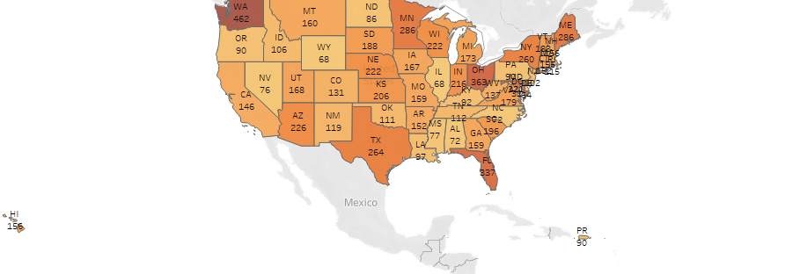
Angina Male Count Measure

Slide 19
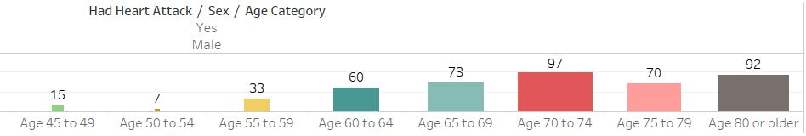
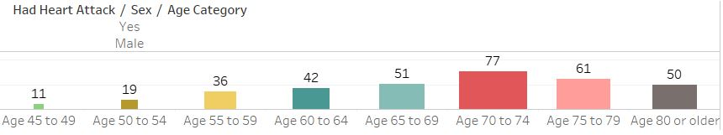
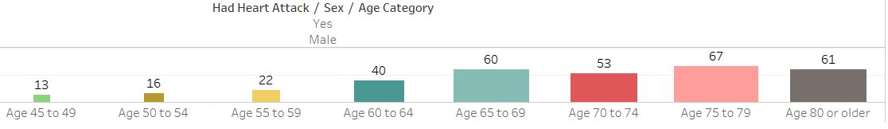
Male Count Measure by Age (Top 3 States)

Slide 20
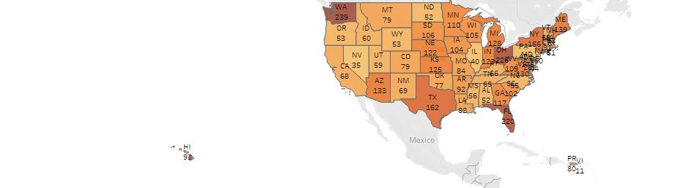
Angina Female Count Measure

Slide 21
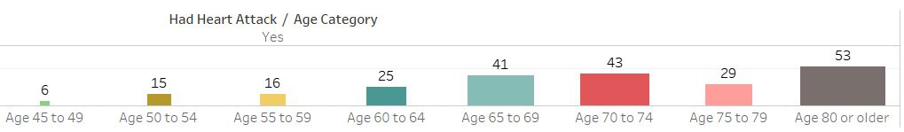
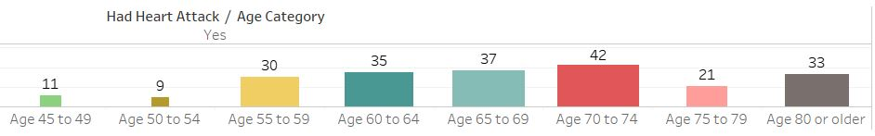
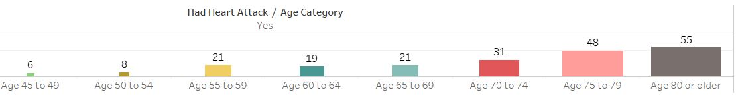
Female Count Measure by Age (Top 3 States)

Slide 22
Data Limitations
From a data gathering perspective especially on lifestyle we need to be vary about the quality and veracity of data.

Slide 23
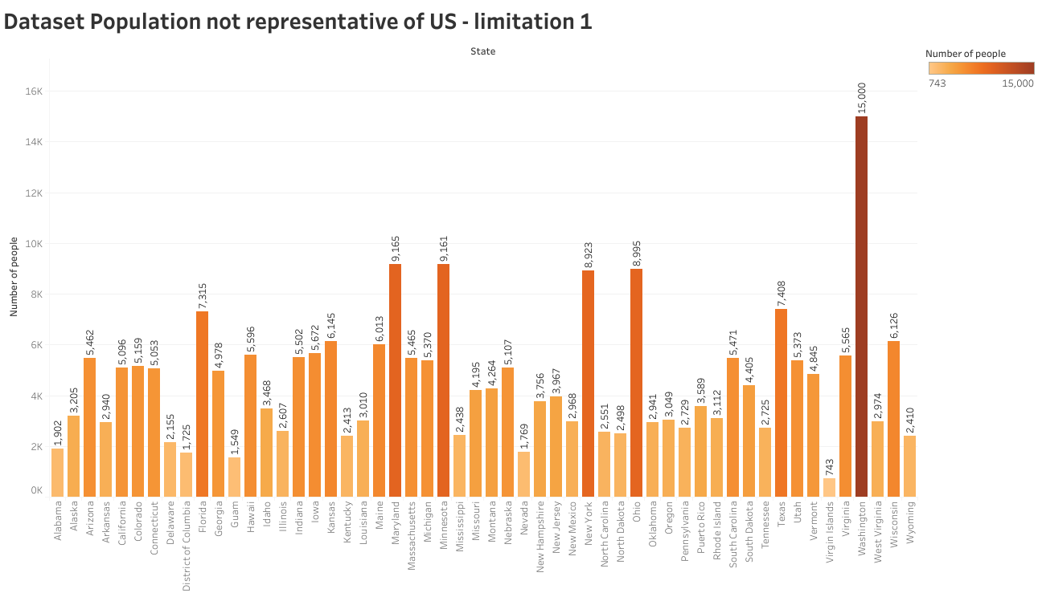
Notes:
This dataset is not representative of the US population in that California is the most populous state in the US but ranks 17th in this dataset.

Slide 24
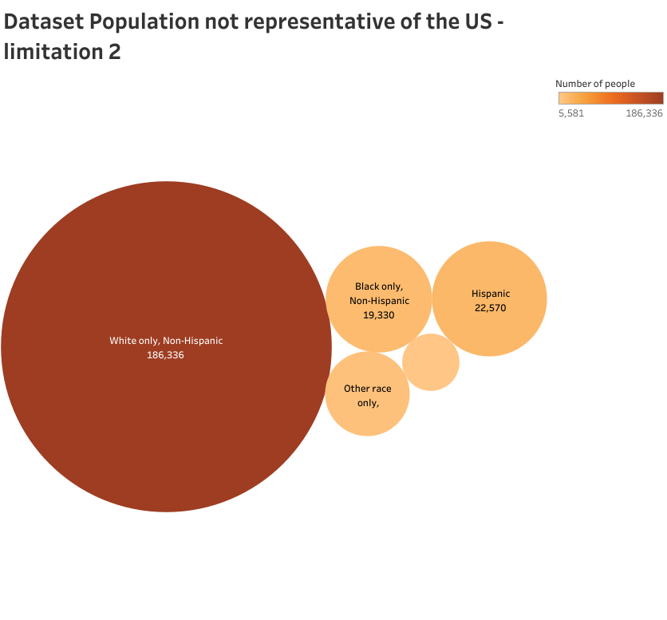
Notes:
This dataset is skewed to represent a large proportion of people of Race-Ethnicity that are White only- Non hispanic. This perhaps has broader implications which probably stem from the unfortunate possibility of people from other races having less access to healthcare and more importantly adequate healthcare insurance.

Slide 25

Thank you!

